Slide 1
Team Epsilon
Team Members:
∙ Thomas Zachry ∙ Diane Chin ∙ Randy Thien Cao ∙ Charlie Pan ∙ Shayan Raza

Slide 2
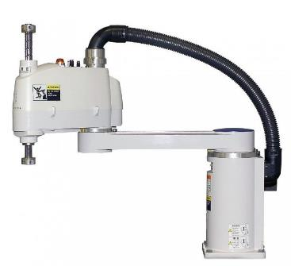
Project :
Scara Robot

Slide 3
PROGRESS
Assembly in progress
OpenRave installed and running

Slide 4
Sprint goals
Finishing fabrication
Finishing simulation design on OpenRave
Creating main executable file in ubuntu
Early stages of UI design

Slide 5
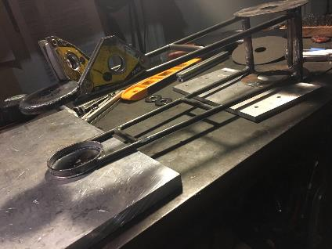
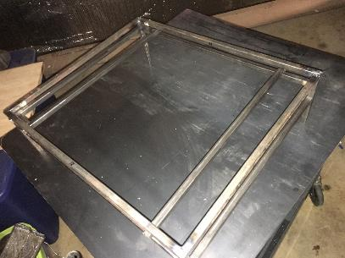
Assembly Progress

Slide 6
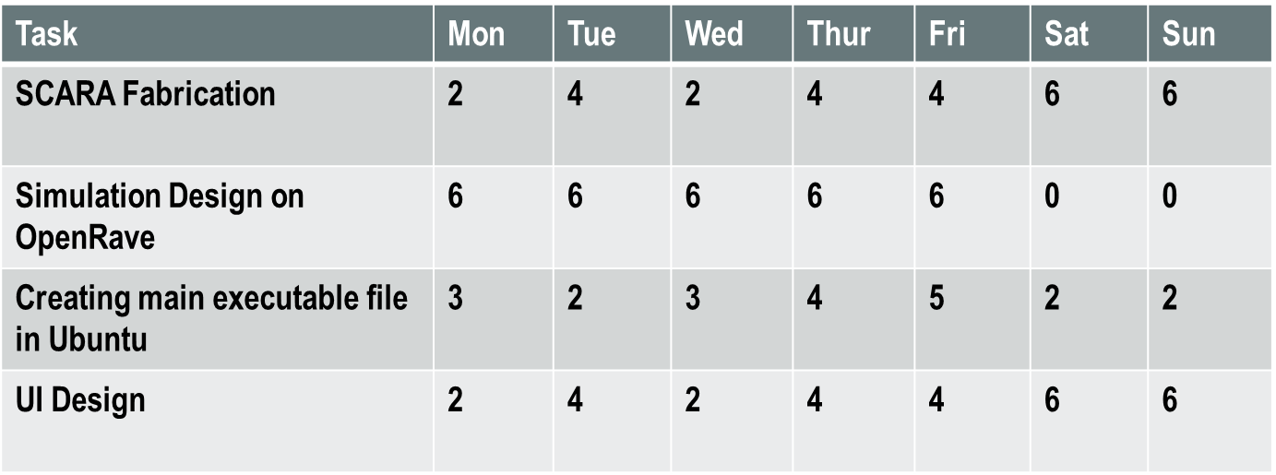
Sprint Backlog

